Slide 1


FDE
LAB REPORT
Sun Zhongji

Slide 2

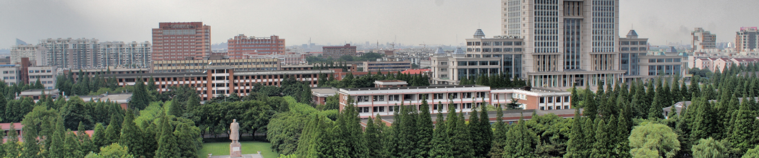
CONTENTS
01
Development Environment
02
Lab 0
03
Lab 4
04
Problems & Improvements

Slide 3

01
Development Environment

Slide 4
Development Environment
Important for HW-SW Co-design!!
OS: Windows 10
Visual Studio: 2019 x64 (unless underlined)

Slide 5
02
Lab 0

Slide 6
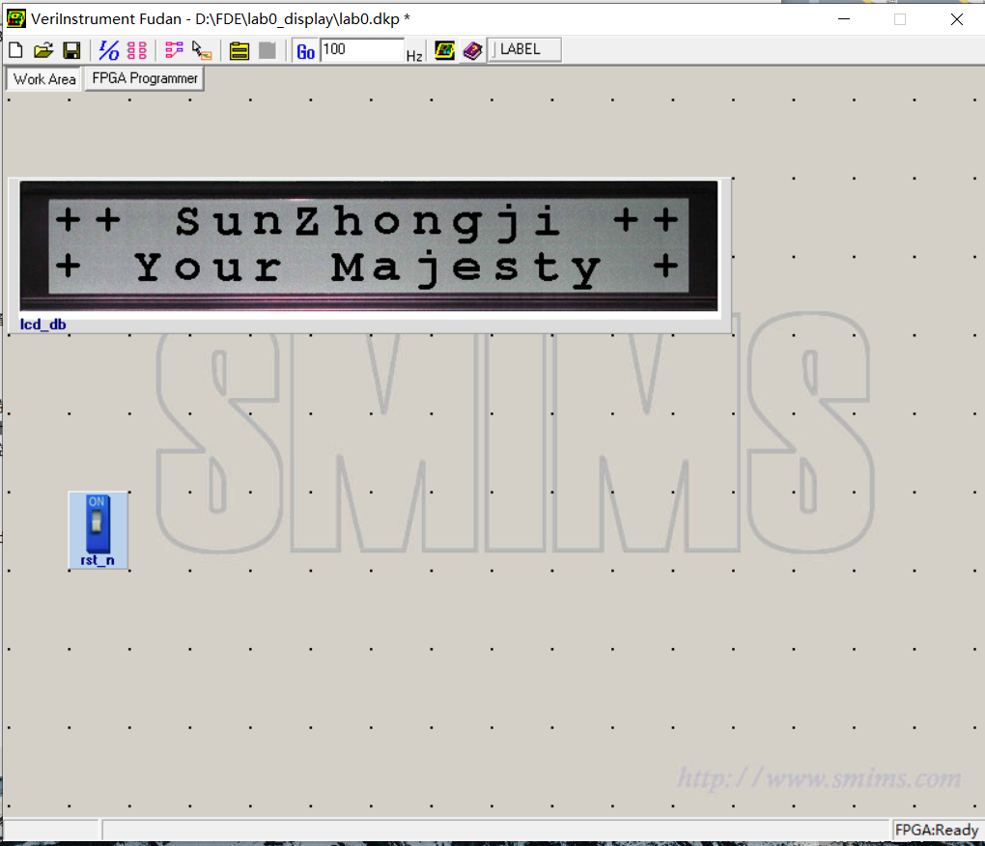
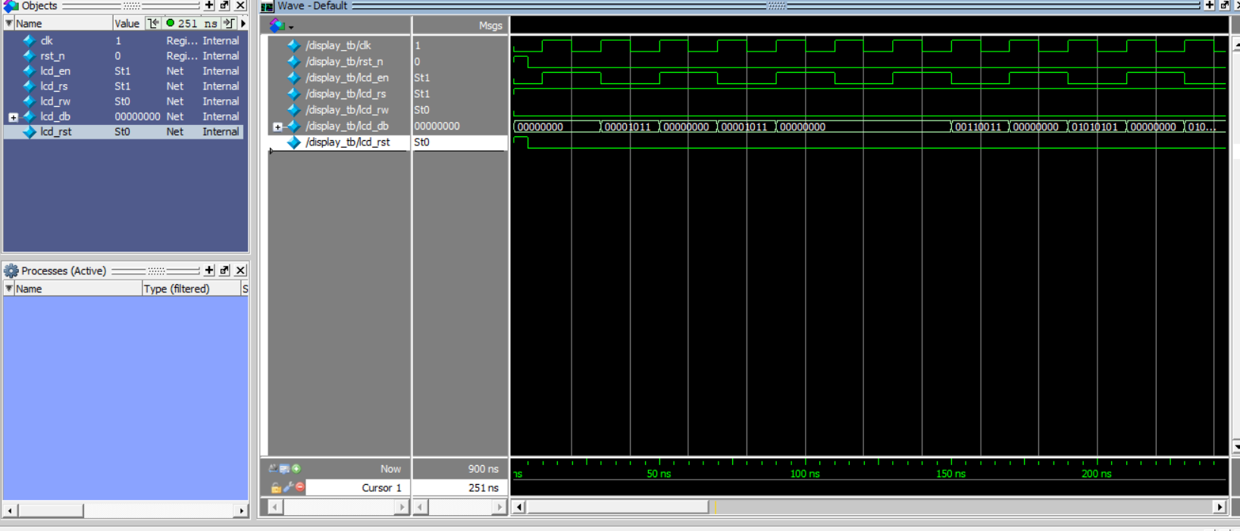
Lab 0

Slide 7
03
Lab 4

Slide 8
Shortcomings
Incompatible with latest version of OpenCV
Fixed constraint file and fixed Verilog logic
Hard to configure by oneself without experience

Slide 9
Rewritten DLL
Supports 64-bit version
Does not use FIFO which results in simpler Verilog code
Output is a clock cycle after input
Update USB protocol
Supported by HDLAutoAssign

Slide 10
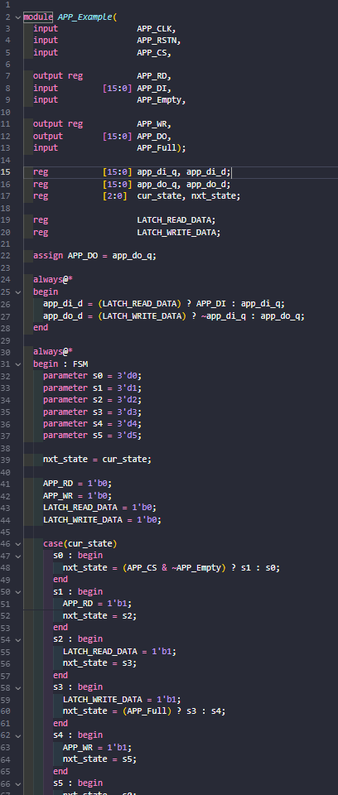
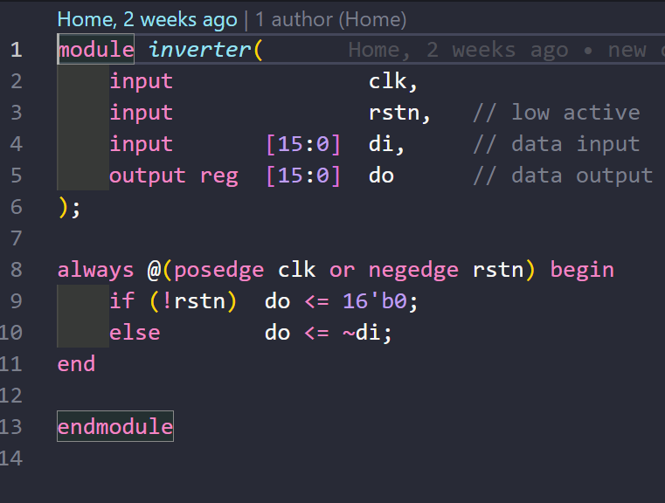
Verilog Code

Slide 11
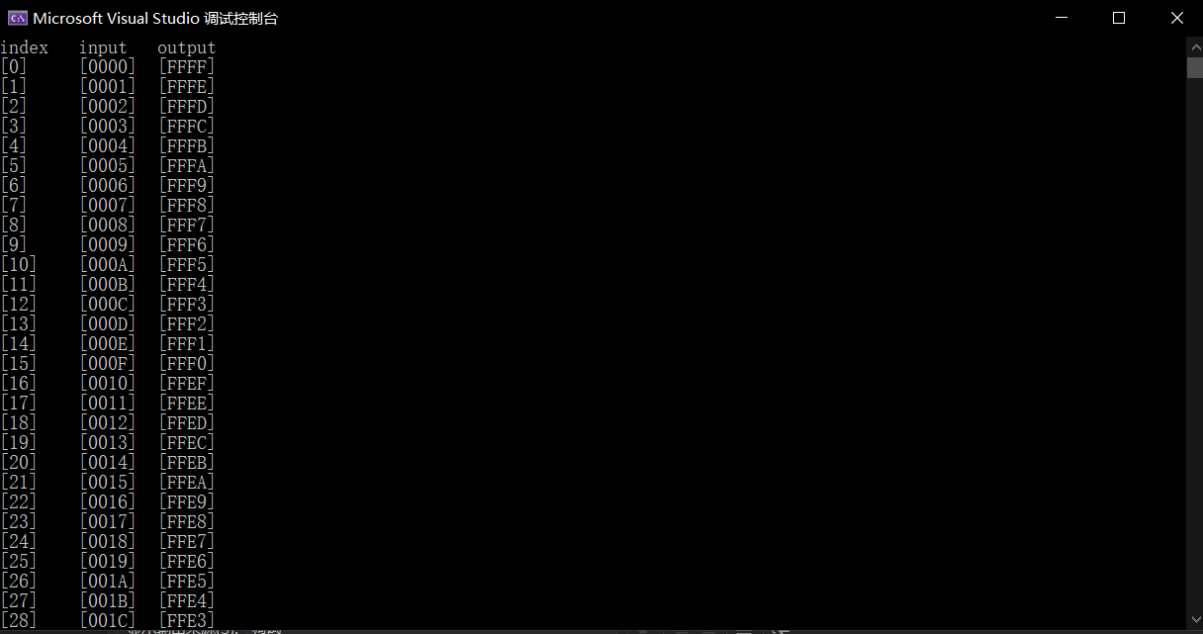
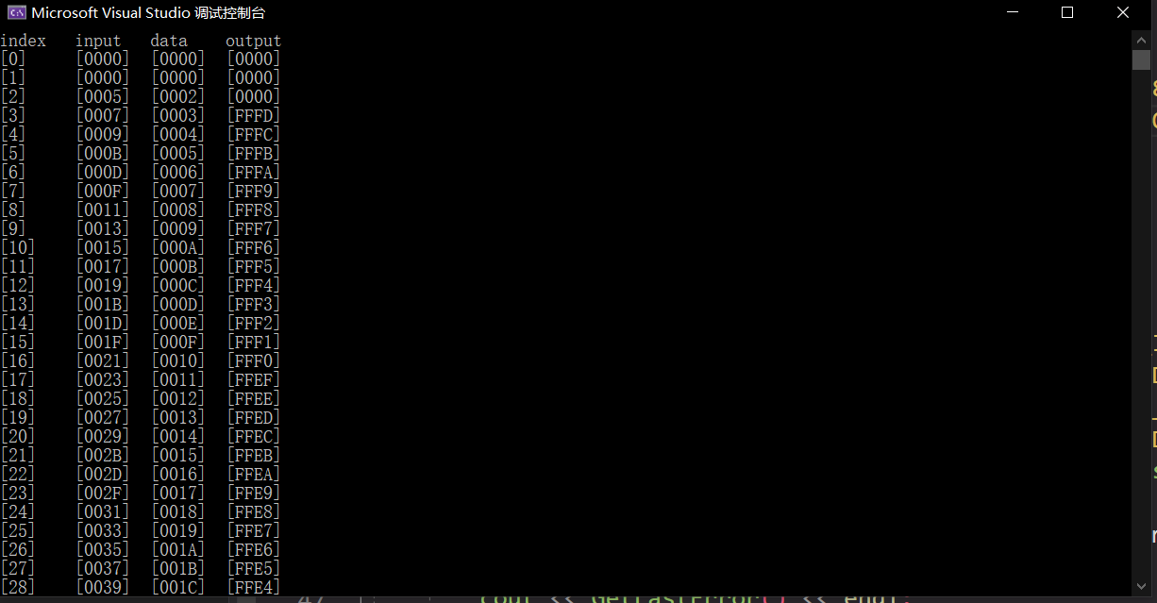
Input & Output

Slide 12
Image Process
GrayScale
Binarization

Slide 13
GrayScale
OpenCV Read in Images
24-bit RGB
Red Green Blue
0.25 0.5 0.25
8-bit GrayScale

Slide 14
Binarization
Threshold is 127 of 0-255
8-bit GrayScale
OpenCV Write out Images
8-bit Binarization

Slide 15

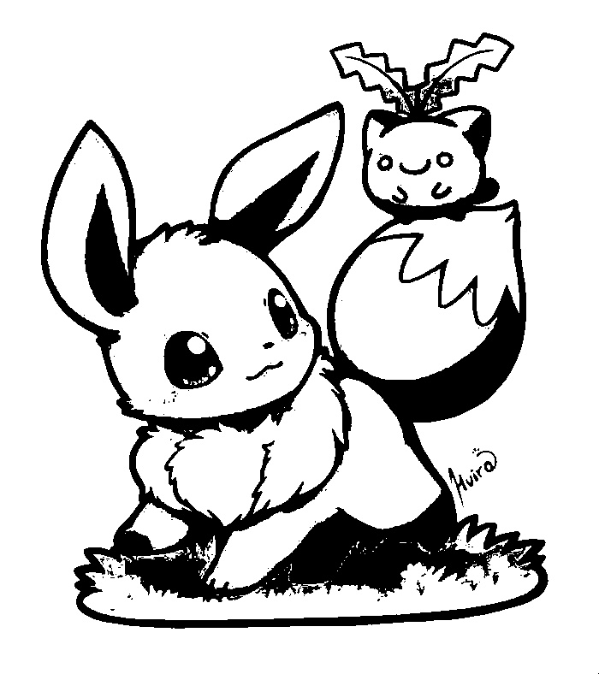

Examples

Slide 16
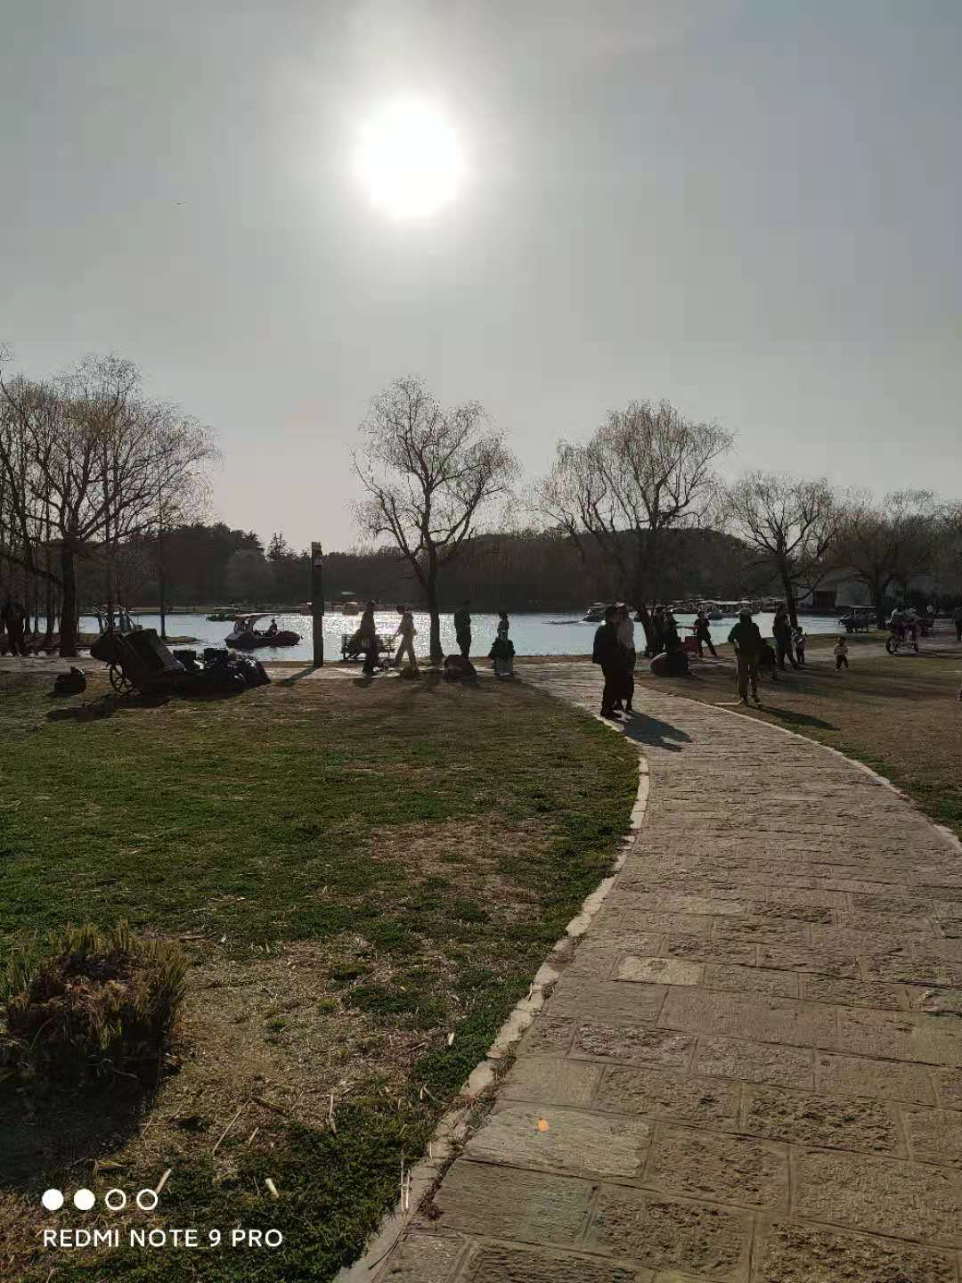
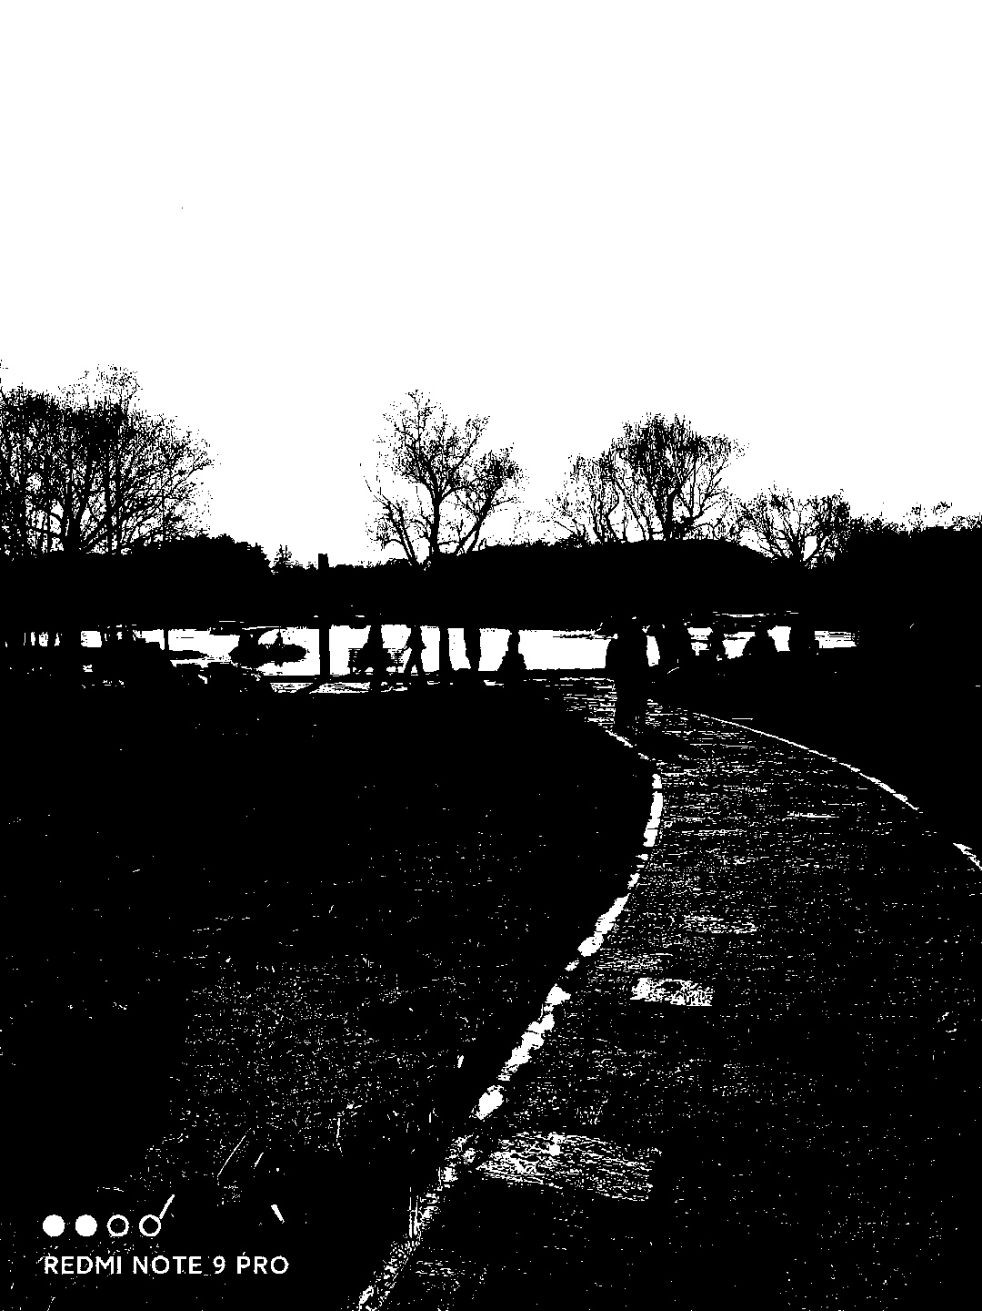
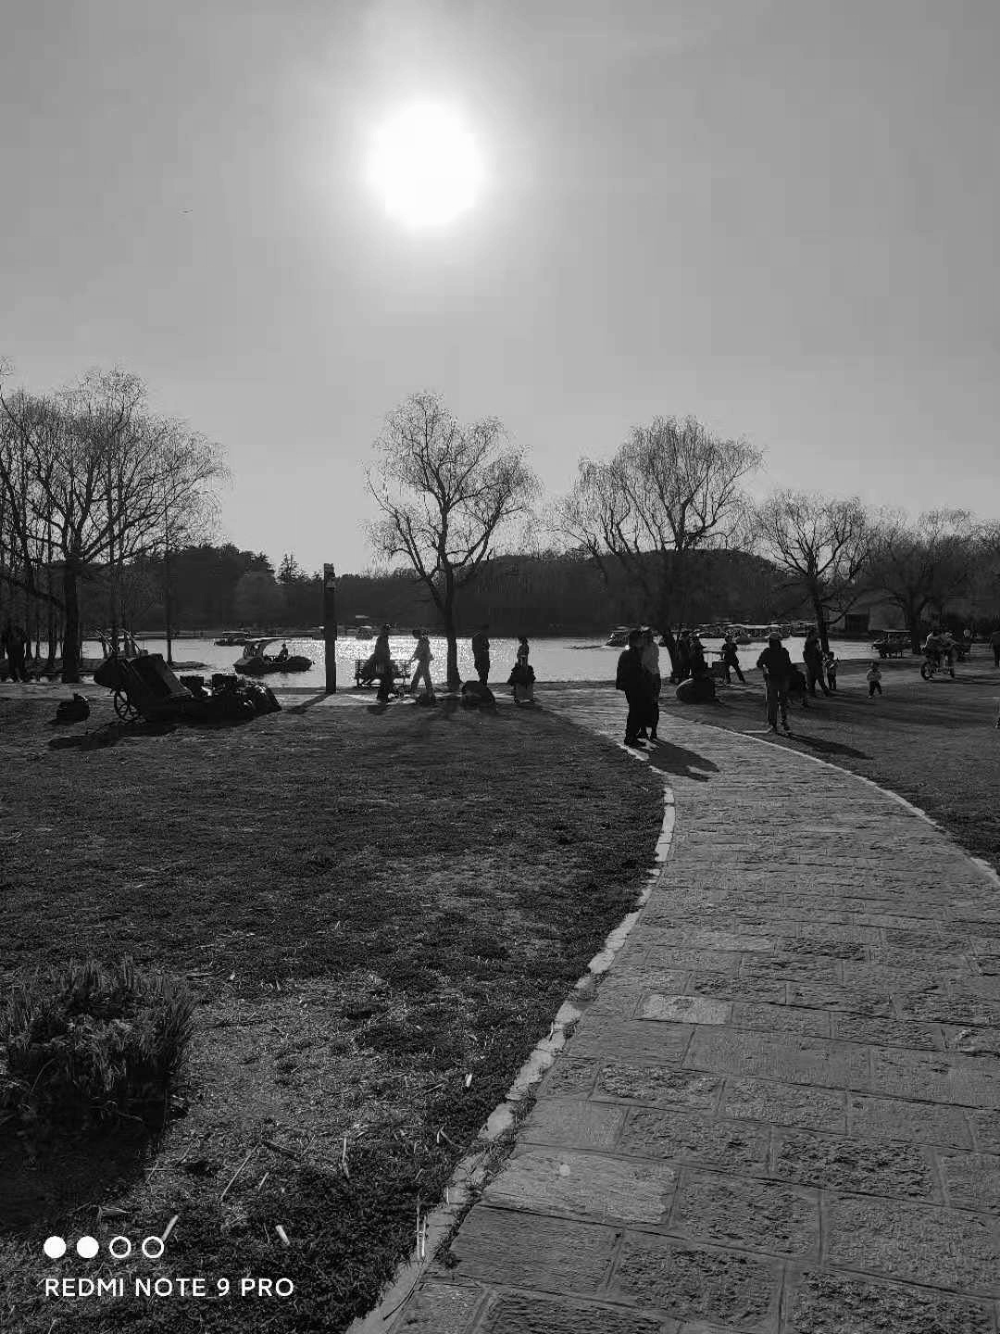
Examples

Slide 17
04
Problems & Improvements

Slide 18
Deprecated Lab 4
VS 2013 x86 for Doc
Hard to configure without previous projects
Incompatible with OpenCV

Slide 19
Deprecated VideoPlayer in VeriComm
Better effects of image process using VideoPlayer shown in Doc
However, Loss of libraries & incompatible with Windows 10

Slide 20
More Knowledge of Image Process
Found a project on Edge Detection using Sobel Factors
However, Use a BRAM to store 3×3 pixel data
Further, most complicated image process needs clutch of data

Slide 21
Thanks for Your Patience!

